Slide 1
Attendance
Stallings, Computer Organization & Architecture (9th Ed.), Chapter 9
Hamacher, Vranesic, & Zaky, Computer Organization (5th Ed.), Appendix E

Slide 2
Computer Organisation
Topic 2
Number Systems
Stallings, Computer Organization & Architecture (9th Ed.), Chapter 9
Hamacher, Vranesic, & Zaky, Computer Organization (5th Ed.), Appendix E

Slide 3

1234
What do you see?

Slide 4
Outline
Decimal systems
Binary systems
Converting between binary and decimal
Converting between hexadecimal and binary
Character Codes
Notes:
LO
Understand the basic concepts and terminology of positional number systems
Explain the techniques for converting

Slide 5
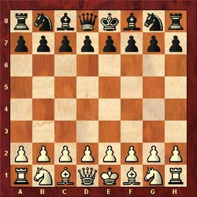
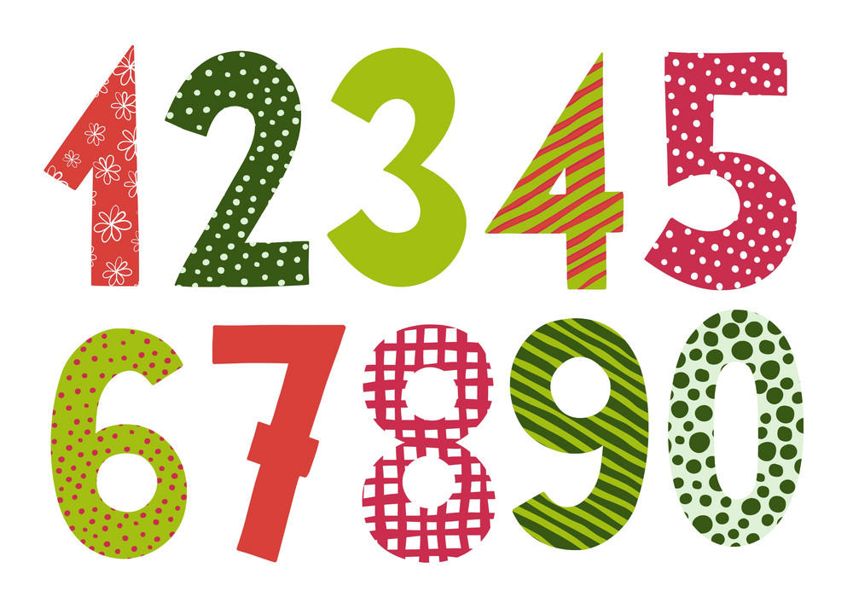
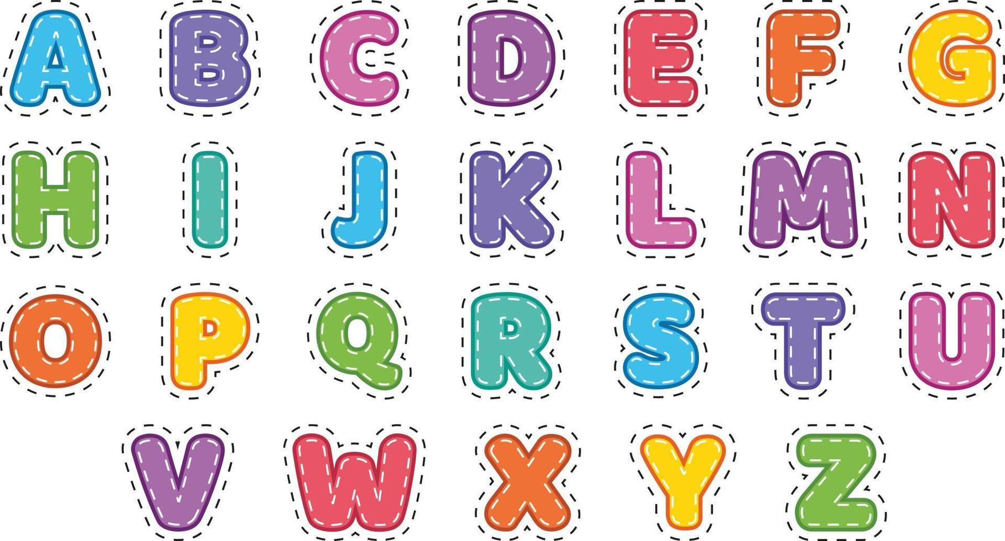
Introduction
One of the characteristics of digital systems:
To represent and manipulate discrete elements of information (10 decimal digits, 26 alphabet letters, 64 squares of chessboard)
Notes:
The number system is a way to represent or express numbers.
You have heard of various types of number systems such as the whole numbers and the real numbers.
But in the context of computers, we define other types of number systems.

Slide 6
Number systems
Decimal Number System (Base-10) – commonly used
Binary Number System (Base-2) – two values ONLY
Octal Number System (Base-8) – commonly used in computer programming context
Hexadecimal Number System (Base-16) – commonly used in CS and programming
Other Number Systems
Base-12 (Duodecimal)
Base-60 (Sexagesimal)
Base-64 (encoding data for transmission)
Notes:
Besides decimal number, binary (base 2), octal (base 8) and Hexadecimal (base 16) are commonly used in the digital electronics system

Slide 7
Types of number system
Base or radix (r)
The value representing the number system
Binary
Base/radix = 2
The range of digits = 0 to (2-1) = 0 to 1
Octal
Base/radix = 8
The range of digits = 0 to (8-1) = 0 to 7
The range of digit representing each base
0 to r-1
Decimal
Base/radix = 10
The range of digits = 0 to (10-1) = 0 to 9
Hexadecimal
Base/radix = 16
The range of digits = 0 to (16-1) = 0 to 15

Slide 8
Quick Activity #0
Identify the radix for the following numbers:
283
54
215
2C
1011

Slide 9


Positional Number Systems
In a positional number system, each number represented by a string of digits in which each digit position i has an associated weight r^{i}, where r is the radix, or base, of the number system.
The value of any digit ai is an integer in the range 0 ≤ i < r.
The dot between a₀ and a₋₁ is called the radix point.
As an example of another positional system, consider the system with base 7.

Slide 10


Introduction
Bits in a computer system are grouped together into cells
An eight-bit memory cell in main memory
0
1
1
0
1
0
1
0
1
7
1
0
2
0
2
0
1
1
0
1
1
0
0
1
N
O
V
E
M
B
E
R
0
0
0
0
0
0
0
0
Notes:
INFO
Computer memories are designed with a most remarkable property
Each storage location can contain either a high-voltage signal or a low-voltage signal ( never anything in between)
The storage location is like being pregnant. Either you are or you are not. There is no halfway ☺

Slide 11
Decimal
The decimal number system is also known as the base 10 system
It is referred to as base 10 because it has 10 different symbols
The based 10 system is also said to have radix of 10
We use decimal systems with decimal digits
0, 1, 2, 3, 4, 5, 6, 7, 8, 9

Slide 12
The Decimal System
Consider what the number 83 means?
Eight tens plus three
83 = (8 x 10) + 3
What about 4728?
Four thousands, seven hundreds, two tens, plus eight
4728 = (4 x 1000) + (7 x 100) + (2 x 10) + 8

Slide 13
The Decimal System
A decimal system is a base or radix of 10
The number multiply by 10 to the power of the digit’s position (place value)
1
0
83 = (8 x 10¹) + (3 x 10⁰)
3
2
1
0
4728 = (4 x 10³) + (7 x 10²) + (2 x 10¹) + (8 x 10⁰)
x
x
x
x
÷
÷
÷
2^{n}
2³
2²
2¹
2⁰
.
2⁻¹
2⁻²
2⁻³
2^{-n}

Slide 14
The Decimal System
The same principles apply to fraction but with negative powers of 10s
0
-1
-2
-3
0.256 = (2 x 10⁻¹) + (5 x 10⁻²) + (6 x 10⁻³)
2
1
0
-1
-2
-3
442.256 = (4 x 10²) + (4 x 10¹) + (2 x 10⁰) + (2 x 10⁻¹)
+ (5 x 10-²) + (6 x 10⁻³)
Leftmost digit = Most Significant bit (MSB)
Rightmost digit = Least Significant bit (LSB)

Slide 15
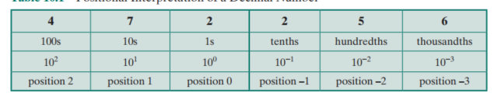
The Decimal System
Positional interpretation of a decimal number
Leftmost digit = Most Significant Bit (MSB)
Rightmost digit = Least Significant Bit (LSB)
Notes:
shows the relationship between each digit position and the value assigned to that position. Each position is weighted 10 times the value of the position to the right and one-tenth the value of the position to the left.

Slide 16

Quick research
How many tens are in the 509?
Notes:
Five hundreds and nine
(5x10²) + (0x10¹) + (9x10⁰)

Slide 17
Introduction
Digital
signal stored in memory can have only a fixed number of value
Discrete elements are represented by signals
Signals have two discrete values: 0 and 1, binary values -> binary digit (bit)
Binary
only two values are possible
Bit
0 or 1
Notes:
INFO
Computer memories are designed with a most remarkable property
In digital electronics, we only deal with 2 possible states (High and Low, ON and OFF, or Open and Closed)
Therefore, for this reason, almost all digital systems use the binary (base 2) number system as the system of its operation
Each storage location can contain either a high-voltage signal or a low-voltage signal ( never anything in between)
The storage location is like being pregnant. Either you are or you are not. There is no halfway ☺

Slide 18


The Binary System
To avoid confusion, we will sometimes put a subscript on a number to indicate its base
For larger numbers, each digit in a binary number has a value depending on its position (as in decimal system)

Slide 19
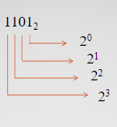
The Binary System
Binary number are strings of two (hence “bi”) symbols 0’s and 1’s, that represent numbers.
10 different digits are used to represent numbers with a base of 10
There are only two digits, 1 and 0
Hence base 2
1
0
4
8
13₁₀

Slide 20
The terminology
BIT
Each digit in the binary system
NIBBLE
A group of 4 bits binary
BYTE
WORD
A group of 8 bits binary
Two bytes number

Slide 21
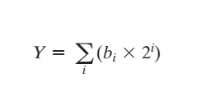
The Binary System
2⁰ = 1
10₂ = (1 x 2¹) + (0 x 2⁰) = 2₁₀
11₂ = (1 x 2¹) + (1 x 2⁰) = 3₁₀
100₂ = (1 x 2²) + (0 x 2¹) + (0 x 2⁰) = 4₁₀
1001.102 = (1 x 2³) + (0 x 2²) + (0 x 2¹) + (1 x 2⁰) + (1 x2⁻¹) + (0 x 2⁻²) + (2 x 2⁻³) = 9.75 ₁₀
1001.102 = (1 x 2³) + (1 x 2⁰) + (1 x2⁻¹) + (2 x 2⁻³) = 9.75 ₁₀
In general, for the binary representation of Y = 5cb2b1b0.b-1b-2b-3c6 , the value of Y is
21

Slide 22
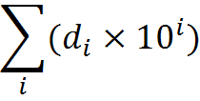
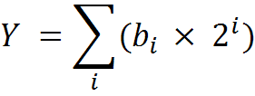
Spot the difference +
Decimal
Binary
X =

Slide 23
research +
What other (popular) number systems are there?

Slide 24
In a nutshell
The binary system is closely tied to Boolean logic, a mathematical system used for representing and manipulating logical values (true and false)
Binary is the natural language of digital electronics.
Data storage in computers, including hard drives and memory, is organized into binary data structures.
Overall, the binary system is fundamental to the operation of computers and digital technology, as it provides a simple and efficient way to represent and process information in a digital form.
Notes:
Boolean logic forms the basis for designing digital circuits and programming logic.
Computers and other digital devices use binary signals to represent and process information.
These signals consist of variations in voltage or current, where a high voltage (often represented as 1) indicates a "true" or "on" state, and a low voltage (often represented as 0) indicates a "false" or "off" state.
Each piece of data, such as a character, number, or instruction, is encoded using a binary representation

Slide 25


Converting From: Binary To Decimal
Multiply each binary digit by the appropriate power of 2 and add the results
Notes:
It is a simple matter to convert a number from binary notation to decimal notation
All that is required is to multiply each binary digit by the appropriate power of 2 and add the results
To convert from decimal to binary, the integer and fractional parts are handled separately.

Slide 26

Converting From: Binary To Decimal
(a₃ a₂ a₁ a₀.a₋₁ a₋₂)₂ → ( )₁₀
(a₃2³ + a₂2² + a₁2¹ + a₀2⁰+.a₋₁2⁻¹ + a₋₂2⁻²)r → ( )₁₀
Example:
(10101.11)₂ → ( )₁₀
4 3 2 1 0 -1-2
21.75
1
1
2¹
2²
1 | a₄
0 | a₃
1 | a₂
0 | a₁
1 | a₀
1 | a₋₁
1 | a₋₂
(1x2⁴) + (0x2³) + (1x2²) + (0x2¹) + (1x2⁰) + (1x2⁻¹) + (1x2⁻²)
16 + 0 + 4 + 0 + 1 + 0.5+ 0.25

Slide 27
Converting From: Decimal To Binary (Integer)
To convert decimal to any other base ‘r’, divide integer part by r and multiply fractional part by r
6
2
13
12
(13)₁₀ → ( )₂
1
1101
?
3
2
6
Divisor (r)
Dividend
6
0
2
13
1
Remainder
2
6
0
1
Less Significant bit
2
3
2
3
1
2
1
2
1
1
0
Most Significant bit
1
0
2
0
1

Slide 28
Converting From: Decimal To Binary (Integer)
(11)₁₀ → ( )₂
1011
5
2
11
10
1
2
11
1
2
2
5
1
2
5
4
1
2
2
0
1
2
1
1
2
2
2
0
0
0
2
1
0
1

Slide 29
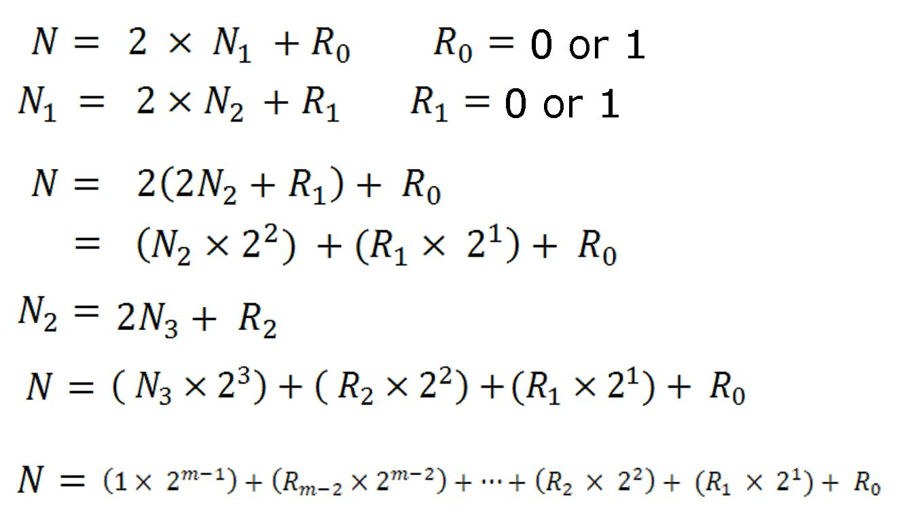
Converting From Decimal To Binary
Decimal integer N to binary with N₁ as quotient and R₀ remainder
,
,

Slide 30
Converting From Decimal To Binary (Fractions)
(25.625)₁₀ → ( )₂
?
11001.101
Step 1
÷
Step 2
x
25
Integer
0.625
Fraction
0.625 x 2 = 1.25
2
25
1
11001
0.25 x 2 = 0.50
2
12
0
2
6
0
0.50 x 2 = 1.00
2
3
1
0.00 x 2 = 0.00
101
2
1
1
0

Slide 31
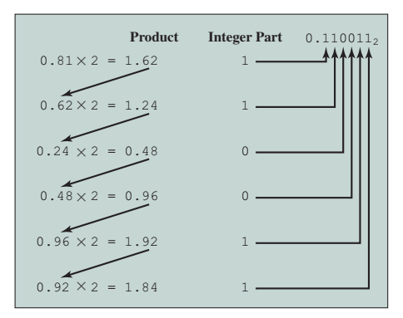
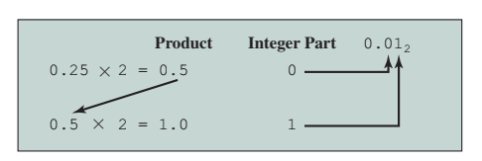
Converting From Decimal To Binary (Fractions)
Notes:
A decimal fraction with a finite number of digits may require a binary fraction with an infinite number of digits. In such cases, the conversion algorithm is usually halted after a prespecified number of steps, depending on the desired accuracy.

Slide 32
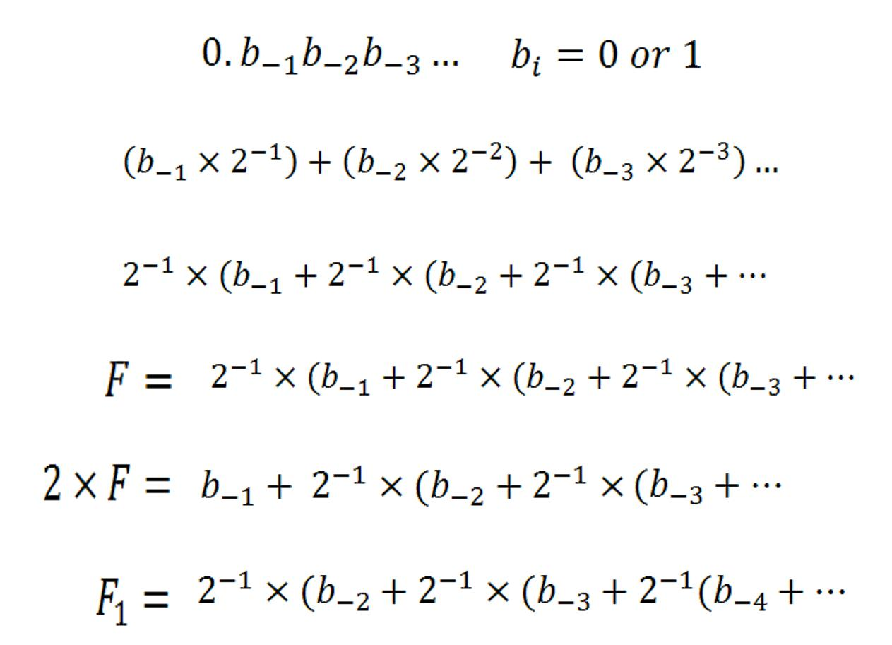
Converting From Decimal To Binary (Fractions)
,

Slide 33
The Hexadecimal Notation
Binary notation is cumbersome
Converting to decimal – tedious
Notes:
Cumbersome = slow or complicated and therefore inefficient.
Because of the inherent binary nature of digital computer components, all forms of data within computers are represented by various binary codes.
However, no matter how convenient the binary system is for computers, it is exceedingly burdensome for human beings.
Consequently, most computer professionals who must spend time working with the actual raw data in the computer prefer a more compact notation.
One possibility is the decimal notation. This is certainly more compact than binary notation, but it is awkward because of the tediousness of converting between base 2 and base 10.

Slide 34

The Hexadecimal Notation
^{r=16}
In hexadecimal number system, we have 16 different digits
Each one of them can be represented by equivalent 4-bit binary number
Better option is hexadecimal – 16 digits 0…9, A, B, C, D, E, F
Notes:
Instead, a notation known as hexadecimal has been adopted.
the decimal system uses ten digits: 0 to 9. Of course, you can count beyond 9. To do so you simply use more than one digit. So, to get past 9 you change the value to 0 and add a 1 to the left. That gives you the number 10.
The base-2 system has just two values: 0 and 1. To represent a number greater than 1 you again use more than one digit. To get to the number 2 you change the number to 0 and stick a 1 in front of it. So, in base-2 the number 2 is written as 10.
Base-16 uses 16 values: the numbers 0 to 9 and the letters A to F. Up to the number 9 the decimal and hexadecimal systems are identical: a base-10 number 9 is also a 9 in base-16. We don’t have a single number for ten, which is why base-16 uses the letters A to F. The letter A is 10, B is 11 etc.

Slide 35
The Hexadecimal Notation
0 | 0000
1 | 0001
2 | 0010
3 | 0011
4 | 0100
5 | 0101
6 | 0110
7 | 0111
8 | 1000
9 | 1001
A | 1010
B | 1011
C | 1100
D | 1101
E | 1110
F | 1111
r = 16
0 will be the first digit
Plus 15 other digits
(10)
(11)
(12)
(13)
(14)
(15)
Notes:
Hexadecimal is a numbering system with base 16. It can be used to represent large numbers with fewer digits.
In this system there are 16 symbols or possible digit values from 0 to 9, followed by six alphabetic characters -- A, B, C, D, E and F. These characters are used to represent decimal values from 10 to 15 in single bits.

Slide 36
The need for hexadecimal numbers
In computing systems, the binary string equivalents of large decimal numbers can become quite long.
When 16- or 32-bit numbers are involved, it becomes difficult to read and write them without producing errors.
These problems can be overcome by arranging the binary numbers into groups of four bits, i.e., by using the hexadecimal numbering system.
The format of hex numbers is more compact than binary numbers because they can represent large binary numbers with fewer digits.
As a result, they are easier to understand than long binary strings of 1s and 0s.

Slide 37
Hexadecimal to Binary
0 | 0000
1 | 0001
2 | 0010
3 | 0011
4 | 0100
5 | 0101
6 | 0110
7 | 0111
8 | 1000
9 | 1001
A | 1010
B | 1011
C | 1100
D | 1101
E | 1110
F | 1111
1. (259A)₁₆ ( )₂
0010 0101 1001 1010
2 = 0010
5 = 0101
9 = 1001
A = 1010
2. (CAFE.3D)₁₆ ( )₂
1100 1010 1111 1110 0011 1101
(10)
C = 1100
A = 1010
F = 1111
E = 1110
3 = 0011
D = 1101
(11)
(12)
(13)
(14)
(15)

Slide 38
Binary to Hexadecimal
0 | 0000
1 | 0001
2 | 0010
3 | 0011
4 | 0100
5 | 0101
6 | 0110
7 | 0111
8 | 1000
9 | 1001
A | 1010
B | 1011
C | 1100
D | 1101
E | 1110
F | 1111
(10001001.11)₂ ( )₁₆
1. Group the integer into 4 bits
10001001.11
2. For the digit with insufficient bit, you will add 00 to complete the group of 4 bits
(10)
(11)
10001001.11
00
(12)
(13)
(14)
(89.C)₁₆
(15)

Slide 39
Binary to Hexadecimal
The binary number is divided into groups of four digits = nibble
110111100001₂
1101
1110
0001
=
DE1₁₆
D
E
1
Notes:
Binary digits are grouped into sets of four bits, called a nibble. Each possible combination of four binary digits is given a symbol, as follows

Slide 40
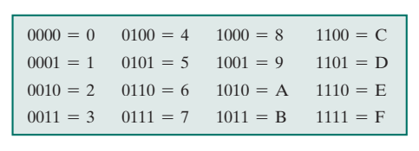
Binary to Hexadecimal
The binary number is divided into groups of four digits
2
C
6
B
.
F
2
00
10110001101011.11110010 =
2C6B.F2₁₆

Slide 41
Decimal to Hexadecimal
Step 1
( ? )₁₆
(479)₁₀
→
479 ÷ 16 = 29.9375 =
29
29 R 15
0.9375 x16 = 15
29 ÷ 16 = 1.8125 =
1 R 13
1
0.8125 x16 = 13
1 ÷ 16 = 0.0625 =
0
0 R 1
0.0625 x16 = 1

Slide 42
Decimal to Hexadecimal
Step 1
( )₁₆
(479)₁₀
→
1DF
29 R 15
15
F
1 R 13
13
D
0 R 1
1
1

Slide 43
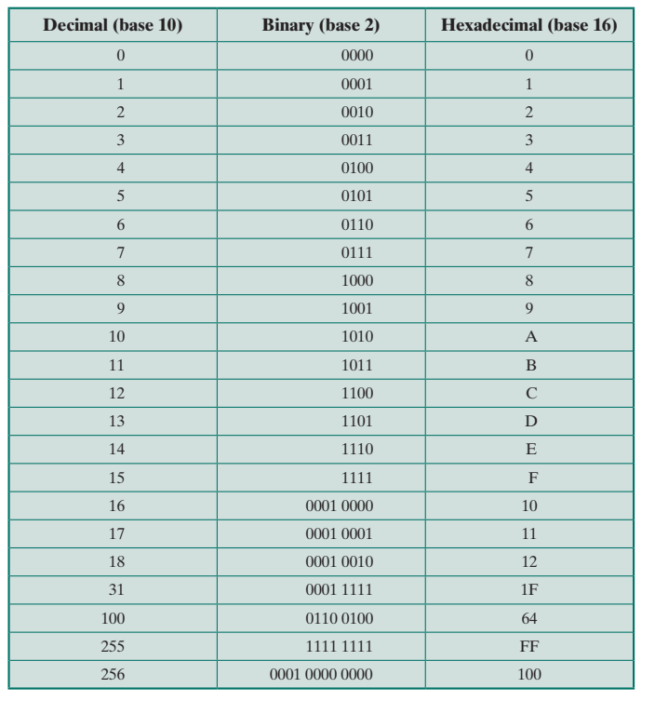

Slide 44
In a nutshell
Hexadecimal notation is not only used for representing integers but also used as a concise notation for representing any sequence of binary digits, whether they represent text, numbers, or some other type of data
The reasons for using hexadecimal notation:
It is more compact than binary notation.
In most computers, binary data occupy some multiple of 4 bits, and hence some multiple of a single hexadecimal digit.
It is extremely easy to convert between binary and hexadecimal notation.

Slide 45
567₈
Convert the above octal number to decimal.

Slide 46
567₈
Convert the above octal number to decimal.
What numbers did you add to get the answer?

Slide 47
Conversion summary
Binary₂
Octal₈
Hexadecimal₁₆
Decimal₁₀
(d x r^{n}) + (d x r^{n}) ………
Binary₂
Octal₈
Hexadecimal₁₆
Decimal₁₀
(÷) with R
Arrange R B-U

Slide 48
Conversion summary
Octal₈
Grouping of 3-bits digit
Binary₂
Decimal₁₀
(d x r^{n}) + (d x r^{n}) ………
Hexadecimal₁₆
Grouping of a Nibble

Slide 49
A98₁₆
Convert the above hexadecimal number to octal.

Slide 50
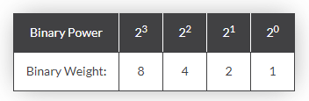
Character Codes : BCD
Decimal digits
Binary Coded Decimal (BCD) code
Decimal digit | BCD code
0 | 0000
1 | 0001
2 | 0010
3 | 0011
4 | 0100
5 | 0101
6 | 0110
7 | 0111
8 | 1000
9 | 1001
Notes:
Binary Coded Decimal, or BCD, is another process for converting decimal numbers into their binary equivalents.
It is a form of binary encoding where each digit in a decimal number is represented in the form of bits.
This encoding can be done in either 4-bit or 8-bit (usually 4-bit is preferred).
It is a fast and efficient system that converts the decimal numbers into binary numbers as compared to the existing binary system.
These are generally used in digital displays where is the manipulation of data is quite a task.
Thus BCD plays an important role here because the manipulation is done treating each digit as a separate single sub-circuit.

Slide 51
Character Codes : ASCII
ASCII stands for American Standard Code for Information Interchange
7-bit ASCII codes (American Standards Committee on Information Interchange)
ASCII codes represent text in computers, communications equipment, and other devices that use text
This code is basically used for identifying characters and numerals in a keyboard.
ASCII is a character encoding method that uses a 7-bit code to represent 128 characters, which include letters, numbers, and special characters.

Slide 52
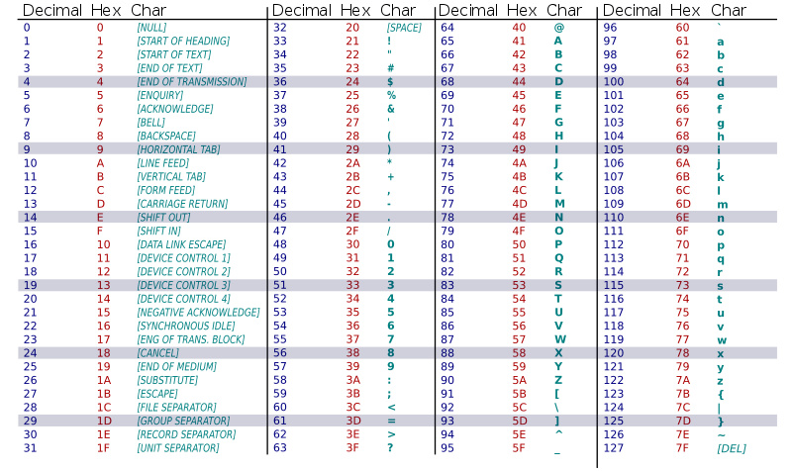
ASCII Code

Slide 53
Character Codes : EBCDIC
An 8-bit character encoding used mainly on IBM mainframe and IBM midrange computer operating systems
EBCDIC has 256 characters and is used to represent a wide variety of characters, such as letters, numbers, special characters, and control characters.

Slide 54
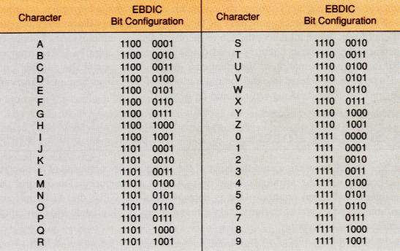
Character Codes : EBCDIC

Slide 55

Reflection…
Watch video on Format Wars: ASCII vs EBCDIC.
Who won/lost and why?
Link on eLearn / Chat
Image source: https://www.flickr.com/photos/29143375@N05/4582236533

Slide 56
